Slide 1
Project Weekly Report
The Satellite Image Analysis
Allu Vamsi Pavan Kumar CSE/19010/437
Vineel Sai CSE/19071/498
Vedant Gupta CSE/190__/4__

Slide 2
Paper - 1: Learning a River Network Extractor Using an Adaptive Loss Function
Paper – 2 : Detecting Waterbodies in Landsat8 OLI image using Deep Learning
Convolutional Neural Networks

Slide 3


Paper - 1: Learning a River Network Extractor Using an Adaptive Loss Function
DATA GENERATION
Data used to train models is randomly generated synthetic data which is basically white lines on black background.

Slide 4
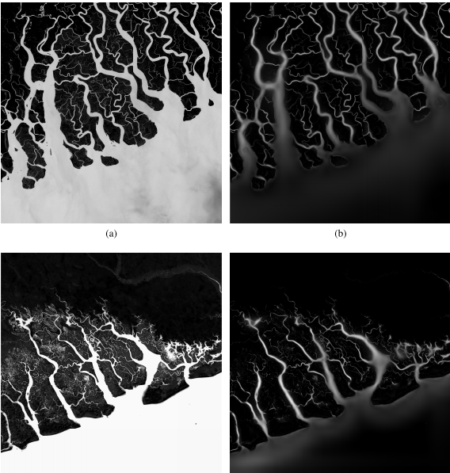
Paper - 1: Learning a River Network Extractor Using an Adaptive Loss Function
TRAINING
Random blur effects, distorsions, contrast shifts, noise, brightness shifts are applied on the synthetic data and the data is trained againest the base image until the model is accurate enough to identify the intersections and differentiate between seas and rivers

Slide 5
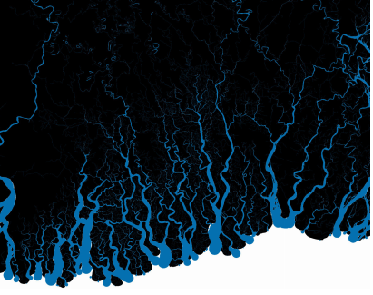
Paper - 1: Learning a River Network Extractor Using an Adaptive Loss Function
DETECTION
After training the model on synthetic data the algorithm is applied on real natural images to get the river outlines. The outcome is extremely resistant to noise because its already trained with noise added to the synthetic data.

Slide 6
Paper - 1: Learning a River Network Extractor Using an Adaptive Loss Function
PROBLEMS TO OVER COME
Since the major part of the image is black pixels and the training is done per pixel the algorithm assumes that black is dominent but to countract that a adaptive loss function is used to calculate the pixels with highest loss function and pooling images based on loss function rather than average and taking the pool size (8x8).

Slide 7
Paper – 2 : Detecting Waterbodies in Landsat8 OLI image using Deep Learning
Dataset
Water body identifying in critical climate change, water resources, ecosystem service and hydrological cycle using Multi-layer Perceptron(MLP).
Four regions ranging from coastal to inland in China are selected as the study area.

Slide 8
Paper – 2 : Detecting Waterbodies in Landsat8 OLI image using Deep Learning
IMAGE PREPROCESSING
The images should be pre-processed to obtain a consistent data. It involves Radiometric calibration and atmospheric Correction.
(Radiometric Calibration to calibrate image data to radiance, reflectance, or brightness temperatures.)
1 . top of atmosphere (TOA) radiance rTOA = a·DN+b
DN donates the original digital number (DN) values. The a and b represent the gain factor and the offset, repressively.
2 . TOA reflectance RTOA =(π·rTOA·d2)/(E0·cosθ)
d represents Earth-to-Sun distance, E0 donates mean exo- atmospheric solar irradiance, θ is the solar zenith angle and π=3.1415926.

Slide 9
Paper – 2 : Detecting Waterbodies in Landsat8 OLI image using Deep Learning
WATER EXTRACTION ALGORITHM
Multi-layer Perceptron (MLP) is a supervised learning algorithm that learns a function by training on a dataset, where m is the number of dimensions for input and o is the number of dimensions for output. Given a set of features X=x1,x2,...,xm and a target y, it can learn a non-linear function approximator for either classification or regression. It is different from logistic regression, in that between the input and the output layer, there can be one or more non-linear layers, called hidden layers.

Slide 10
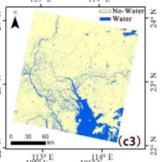
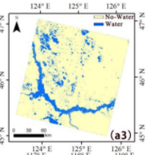
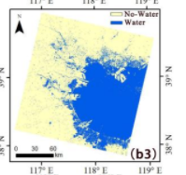
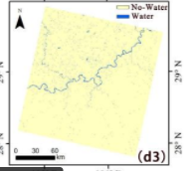
Paper – 2 : Detecting Waterbodies in Landsat8 OLI image using Deep Learning
PARAMETERS
Hidden Layers : 4
Batch size : 2
Epochs : 200

Slide 11
Convolutional Neural Network
What is convolution
Measure the overlap between f and g when one function is “flipped” and shifted by x.
The input is a two-dimensional tensor with a height of X and width of Y.
The shape of the kernel window (or convolution window) is given by the height and width of the kernel (here it is 3 × 3).

Slide 12
Convolutional Neural Network

Slide 13
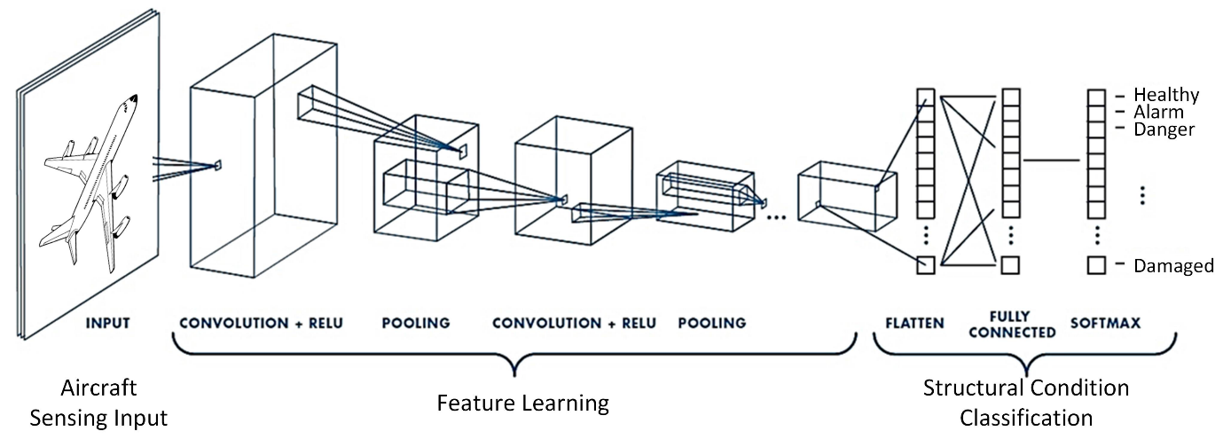
Convolutional Neural Network

